Slide 1

Auto Price & credit risk Prediction models
Presented by
Ama Ananaba & Anthony Iwu

Slide 2

Auto price prediction procedures
Source the data
Clean the data
Split the data for model training and testing
Train the model
Evaluate the model

Slide 3
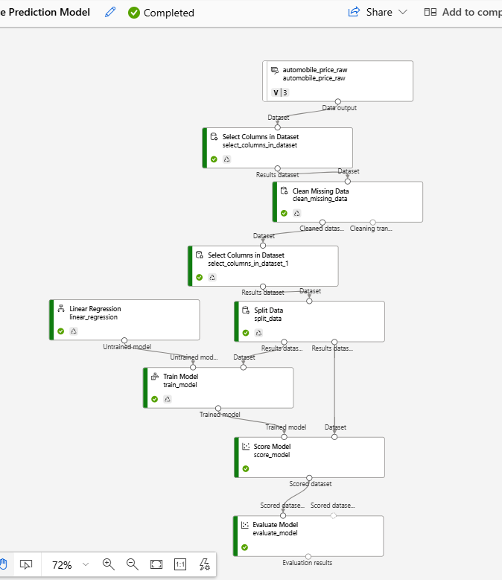
Price predictor model pipeline
Linear Regression Model is used because of its simplicity, computational efficiency and understanding of relationships between different factors and car prices.

Slide 4
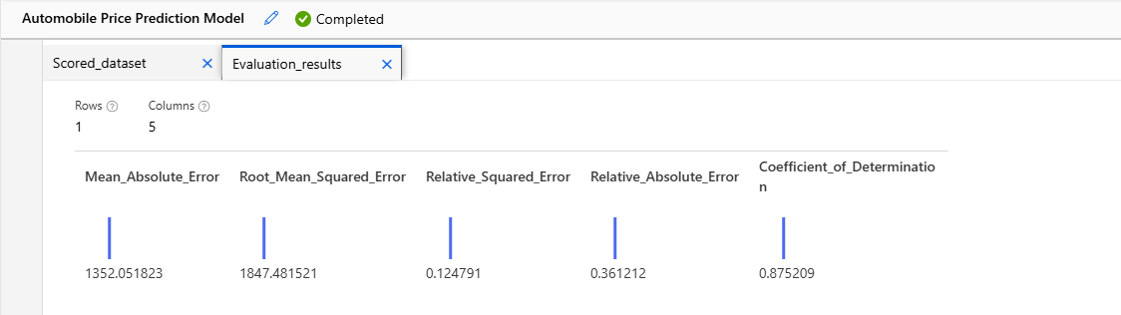
Price predictor model evaluation
The evaluation report suggests that the model is apt and efficient at predicting car prices given all the various factors that could influence said prices with great accuracy over time.

Slide 5
Credit risk prediction procedures
Source the data
Clean the data – edit possible metadata
Split the data for model training, normalizing, and testing
Train and normalize the model
Evaluate the model
Deploy the model

Slide 6
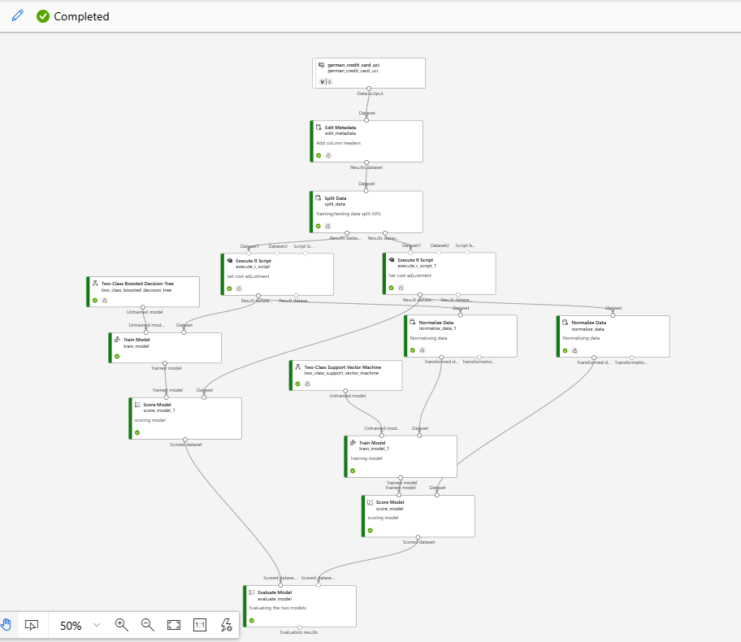
Credit risk prediction model pipeline
Before training the model, two operations were done:
Execution of R programming script – to create custom data transformations
Use of Boosted Decision Tree and Support Vector Machine – for efficient training and prediction accuracy

Slide 7
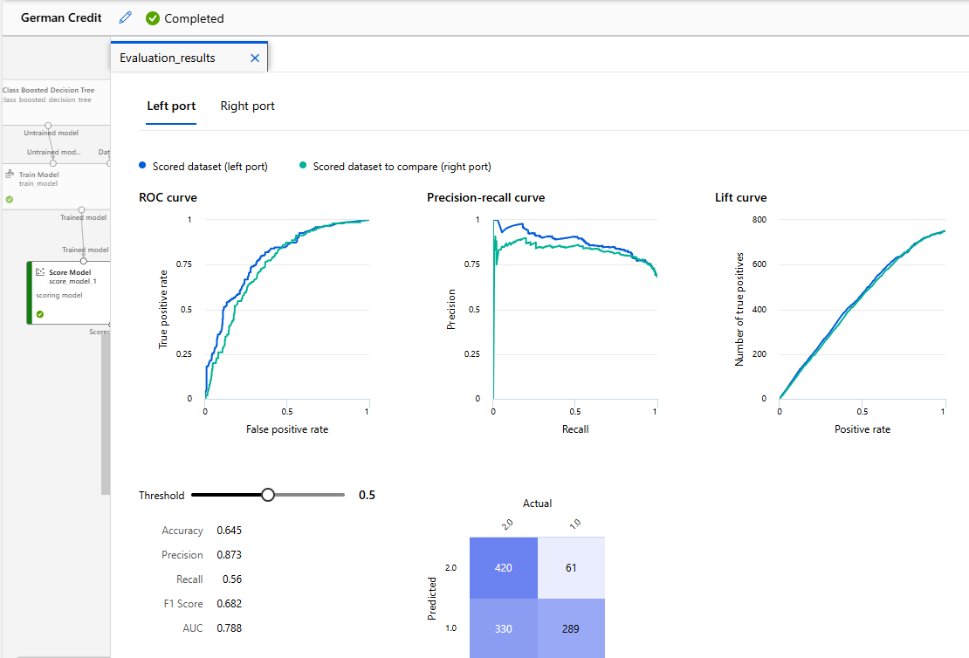
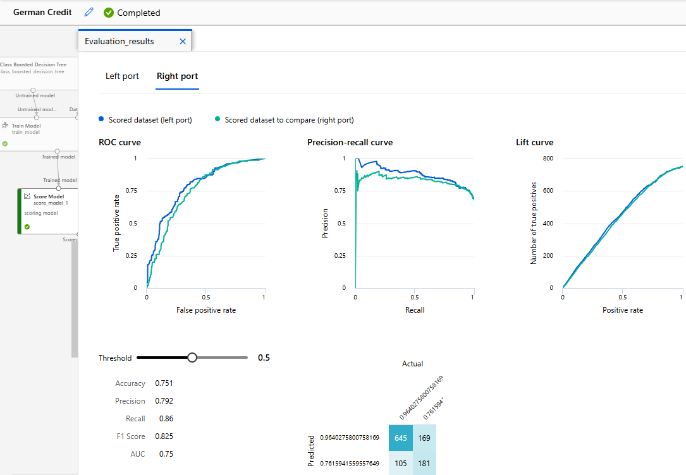
Credit risk model evaluation
Divided into 2 – Left port & Right port; the model proves high grade prediction scores with Accuracy, Precision and F1 scores above 80%.

Slide 8
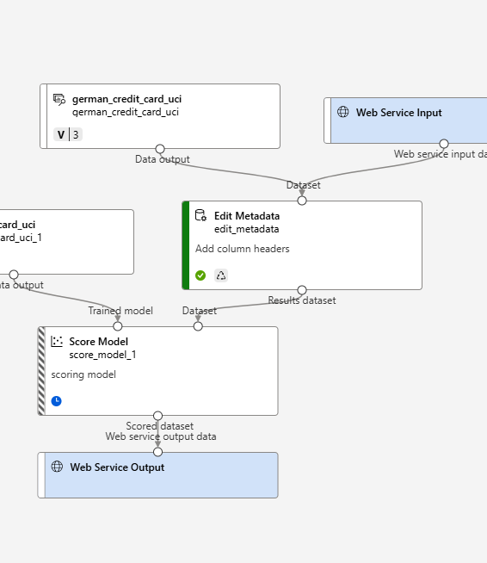
Credit risk model deployment
After training, testing, normalizing and evaluating, the model is ready for web deployment.
At this stage, it is ready to predict using risk levels using input from users with access on the web.

